Slide 1



ALMA
RF team,
Welcome to the future of education
Enjoy!
23 Aug 2026

Slide 2
Learning is fragmented.
48 tools
One study session. Five disconnected products.
accessed by the average student each year
AI sits outside the student’s work.
$455B+
EdTech uses the wrong interface for STEM.
spent on EdTech and tutoring globally each year

Slide 3
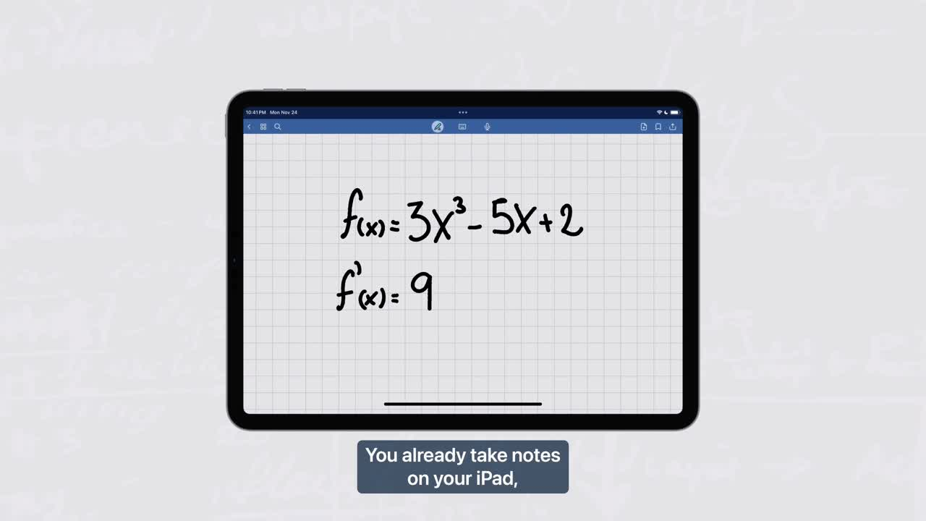

Slide 4

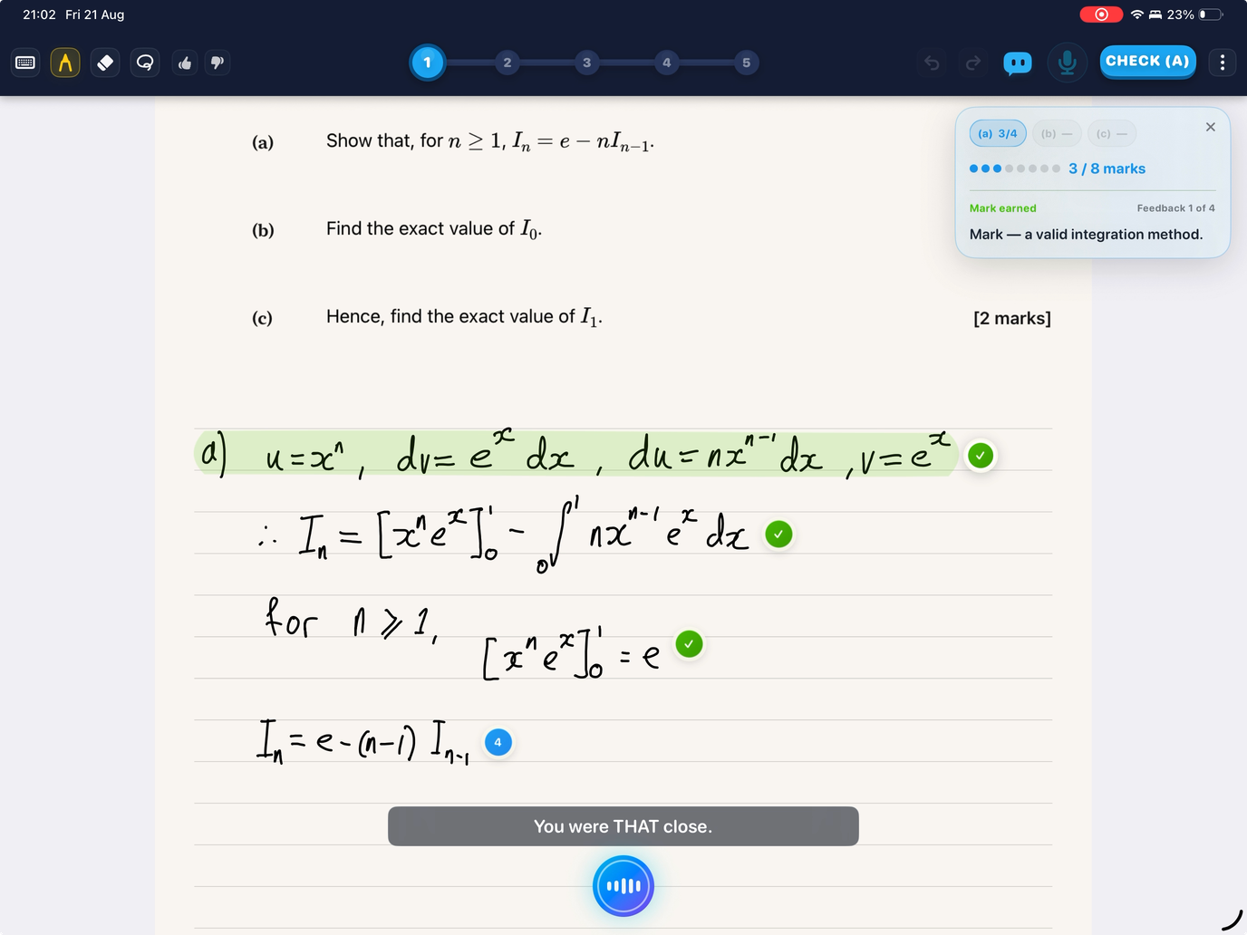
Alma sees everything.
Alma reads your handwritten working, marks every step and teaches directly on the page.

Slide 5
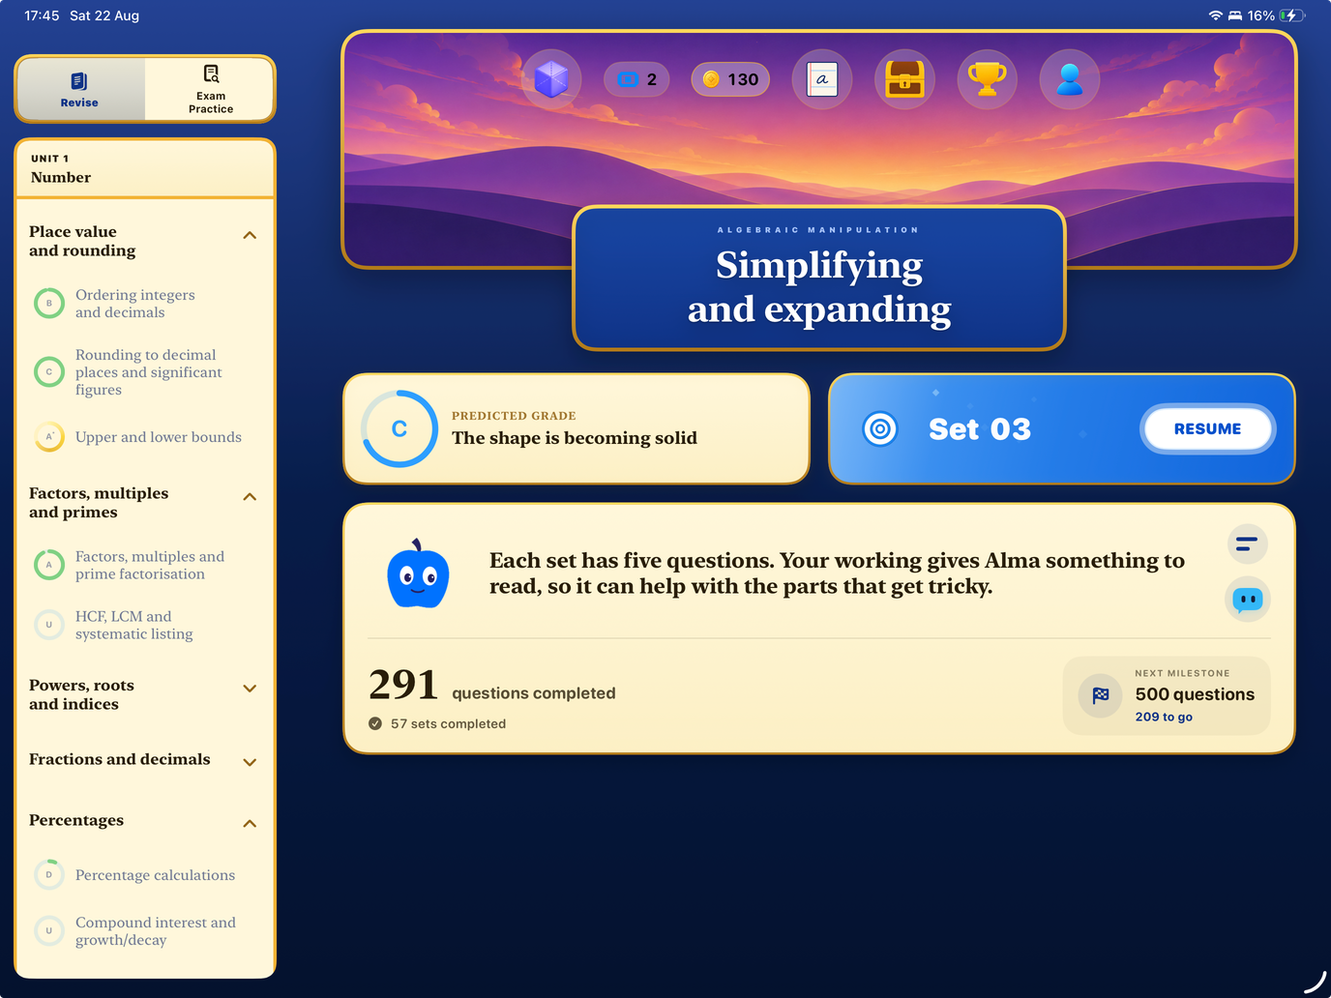
Every answer changes what comes next.
Alma learns what you know, what you struggle with and chooses what you should practise next.

Slide 6
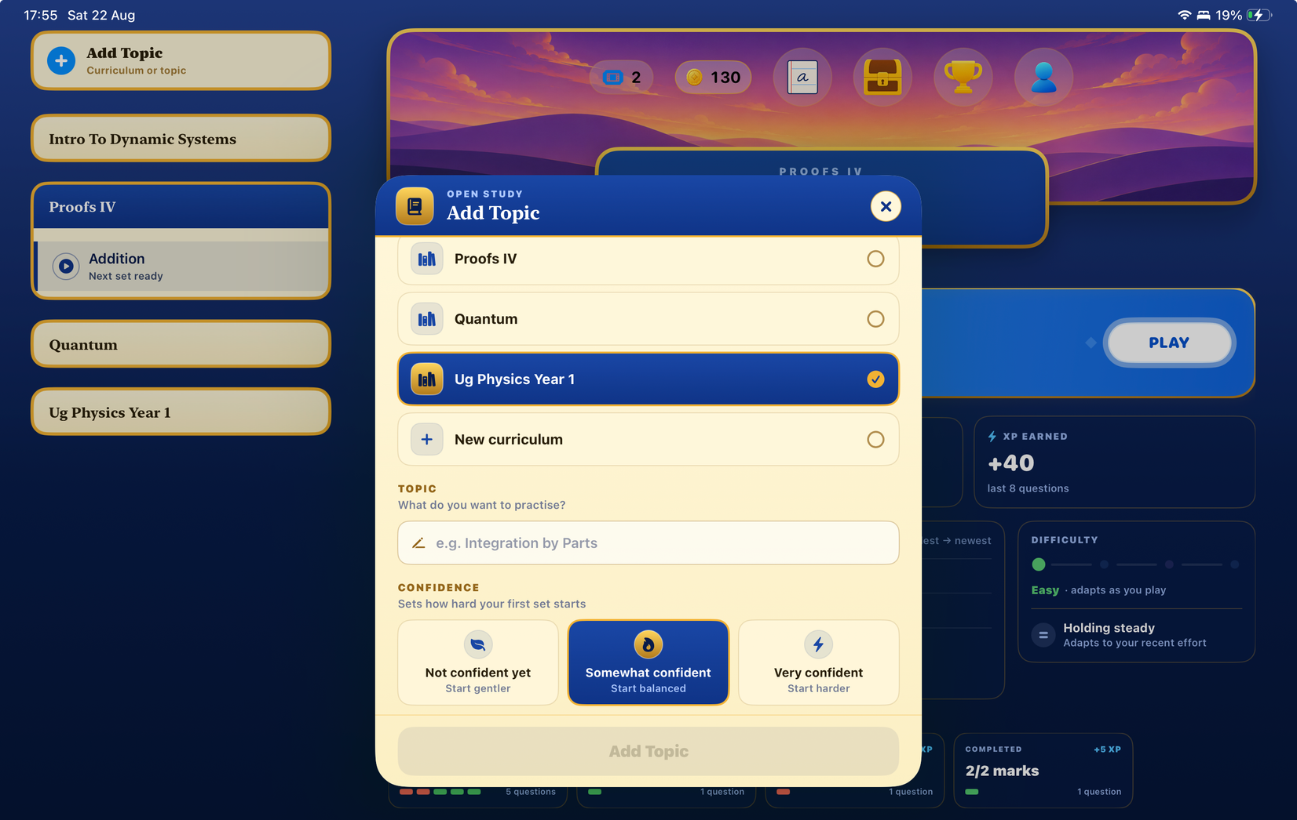
Learn anything.
Choose your subject, curriculum and difficulty. Alma builds the practice around you.

Slide 7
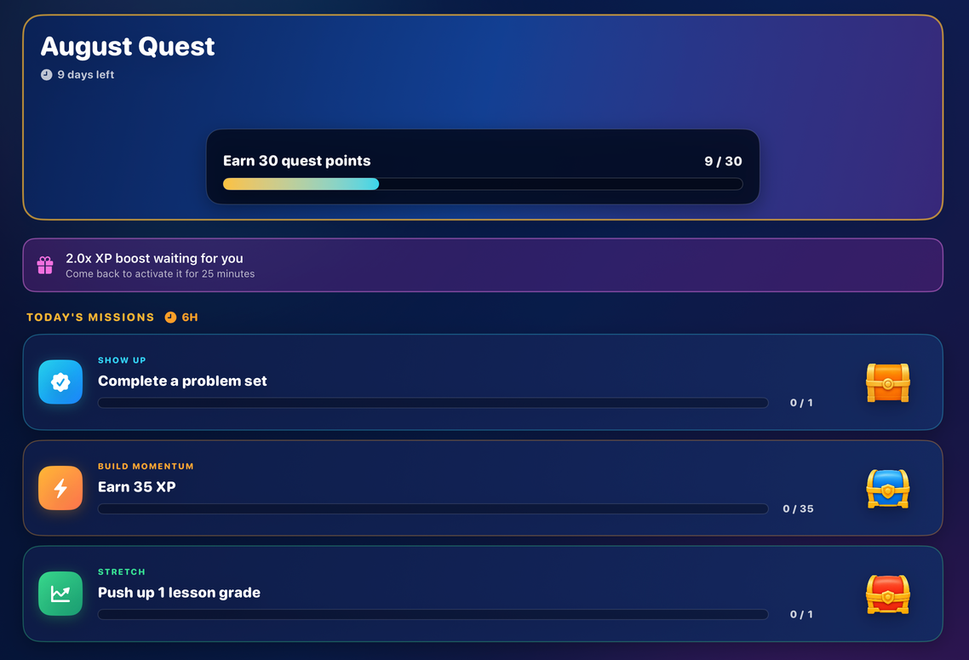
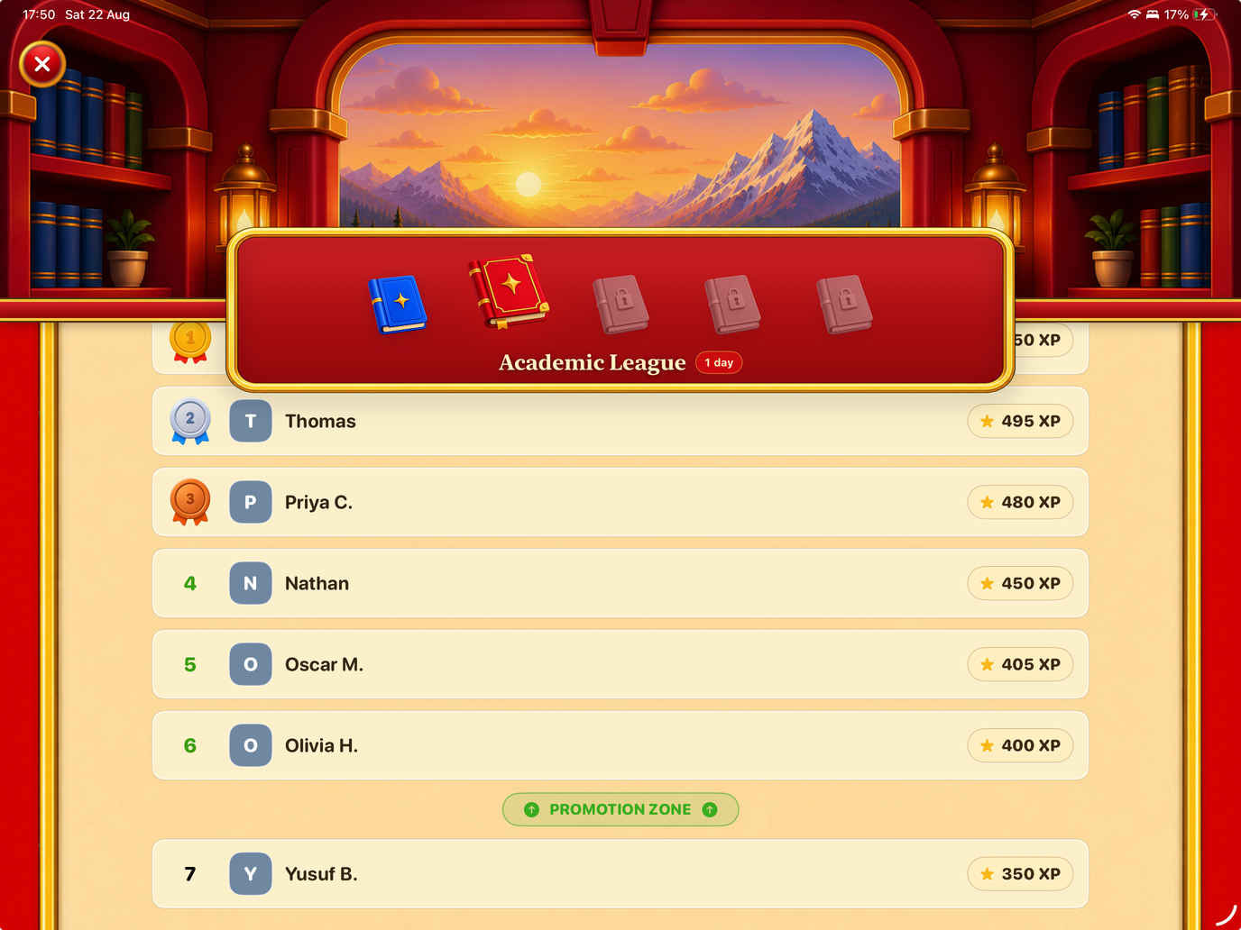
Progress you can see. Reasons to come back.
Alma turns academic progress into a game students want to keep playing.

Slide 8
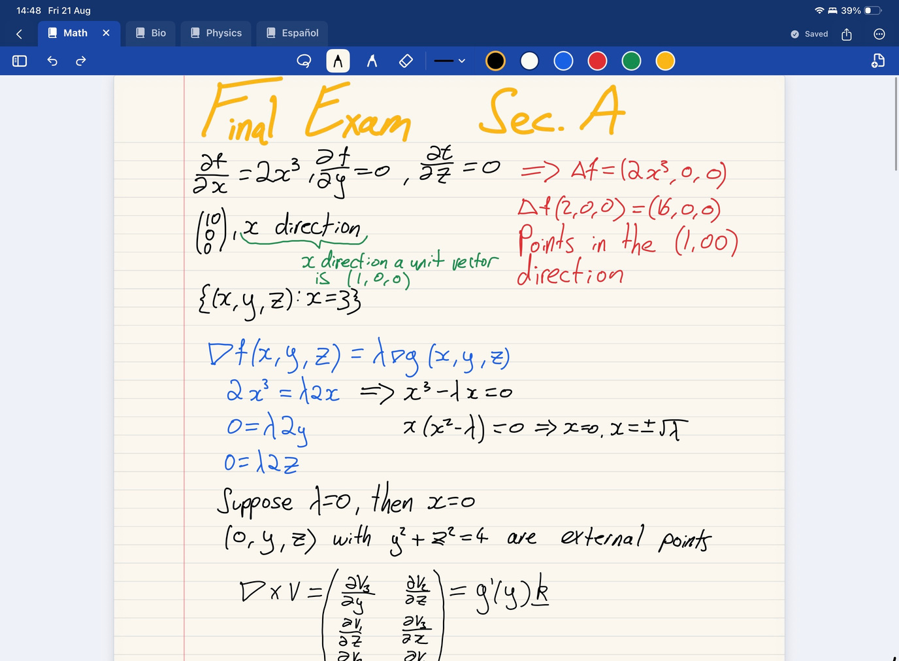
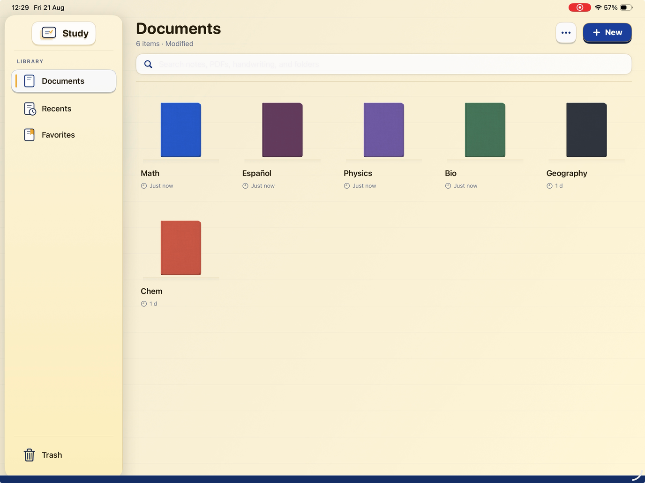
Your notes. Completely free.
Come for the free notes, stay for the learning system.

Slide 9
I was the user.
Then I became the builder.
Building for the generation I belong to
1 year full-time
0 → shipped
7000+ downloads

Slide 10
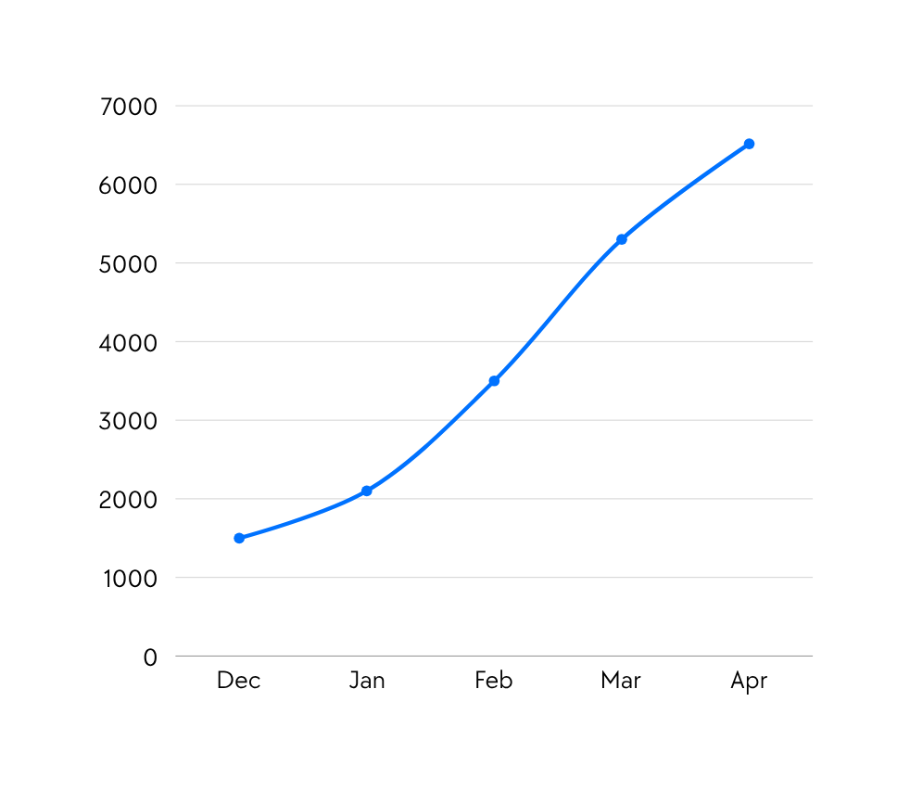
Demand compounded
57.8 min
average engagement / active user
6,516
first-time downloads, Dec-Apr
Notes:
[Sources]
Alma_Traction.pdf, page 3.
Source: App Store Connect; cumulative first-time downloads Dec 2025–Apr 2026.
6,516 downloads through April; 57.8 min average engagement per active user.

Slide 11
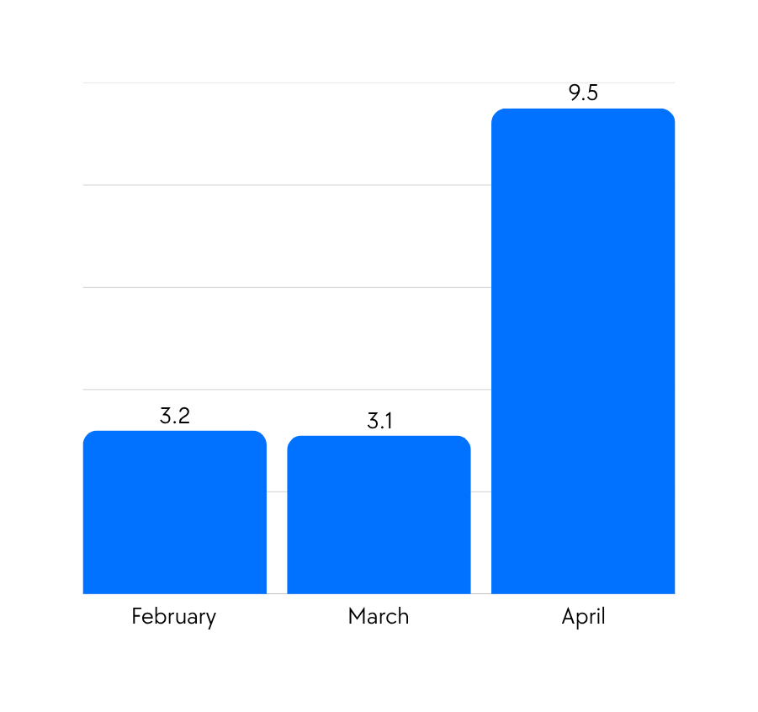
Testing produced a winning-format
Downloads per £1 spent
9.5
Downloads per £1 in April
3.1x
March’s download rate
Notes:
[Sources]
Alma_Traction.pdf, page 5.
Sources: App Store downloads and recorded Google Ads spend.
Directional ratio: downloads ÷ spend; April spend covers 1–9 Apr 2026.
February 3.2; March 3.1; April 9.5 downloads per £. April is 3.1× March’s recorded rate.

Slide 12
